Slide 1
Virtual Adventures for Youth Ministry
“What We Think Matters”
Notes:
Suggestions for use:
Begin by starting Zoom or other video conferencing system and welcoming everyone.
Once welcome is complete,
Click the “Share Screen function within Zoom
Before you share, make sure both of the options, which can be found on the bottom of the screen, are checked: “Share computer sound” and “Optimize screen share for video clip,” then click “share screen.
The share screen will open, locate the PowerPoint, click it and then click “share.”
Once the screen is shared, click into PowerPoint and turn on the slide show so it shows full screen.
Slide 1 is the introduction – you may want to share the title

Slide 2
Setting the Stage
Through Rainbow Crow’s selfless act, many were saved but Rainbow Crow was also called to think of himself in a new way.
Notes:
Suggestions for use:
Slide 2 shares the story overview –
Optional – invite the children to talk crows or what it means to be selfless.

Slide 3
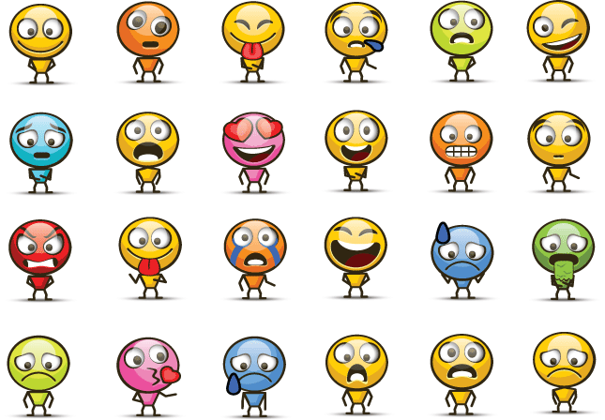
Building Community
You are invited to draw or circle and emoji that best describes how you are feeling today.
And/Or
Invite the children to post in the chat, how they are feeling today.
Notes:
This slides introduces the community building activities. Tell the children that in a moment they will have the opportunity to draw or write about that they love about themselves.
Invite them to use the Chat feature to write about themselves. While they are posting in the chat…
Go to the next slide and invite them to use the “Annotate” feature to draw something they like about themselves.

Slide 4
Circle the emoji that best describes how you are feeling. Or, you may draw your own.
Notes:
When this slide loads, click the “Annotate” button at the top. A set of tools will open.
Invite the children to also click the “Annotate” button and invite them to circle the emoji that best describes how they are feeling. Or, invite them to draw their own.
If time allows, invite them to talk about how they are feeling today.
When the children are finished – you can save the slide, if you chose, by clicking on the ”save” button on the annotation tool bar. It will be saved to your computer.

Slide 5
Rainbow Crow, Retold by Nancy Van Laan
Notes:
Share the story by either playing the video within the PowerPoint or click the Youtube link and watch online.
https://youtu.be/2Mw6IKka448

Slide 6
Discussion
When the Creator thought about snow and ice, how did the world change?
What did the animals decide needed to be done?
Who volunteered and then what happened?
How did Crow capture the Creator’s attention?
What did the Creator say about once a thing has been thought?
What happened after Crow received the Creator’s gift?
What was the Creator’s final message to Crow?
Tell me about something that happened that you did not like?
What did you say and think about it?
How can you find goodness within it?
Notes:
Once the video is complete, engage the children in a brief discussion about the story.
When the Creator thought about snow and ice, how did the world change
What did the animals decide needed to be done?
Who volunteered and then what happened?
How did Crow capture the Creator’s attention?
What did the Creator say about once a thing has been thought?
What happened after Crow received the Creator’s gift?
What was the Creator’s final message to Crow?
Tell me about something happened that you did not like?
What did you say and think about it?
How can you find goodness within it?

Slide 7
Activity: “My Thoughts & Words Have Power”
Supplies needed: Bubbles & a wand
Think about how once you blow a bubble it just floats away…
Notes:
My Thoughts & Words Have Power
Share with the children this statement from the story: “Once a thing has been thought, it cannot be unthought.”
Invite them to share what this means to them.
You can also provide examples of sending out a thought and trying to unthink it
Then invite them to blow a bubble – if their cameras are on you can see them blowing the bubbles and describe what happens to it.
Does it stay put or float away?
Who does it touch?
Can they put the bubble back in the bottle.
Then invite them to think of the bubble as a thought… Is the thought they are thinking something they want to float away or do they want to think a new thought?
Just like the bubble ”Pops” and slashes those nearby, our thought float out and affect others.
Zoom allows you to share documents so go into the chat area and upload the ”Thought Handout” and invite the parents to download it so the children can use it.
Invite them to review the handout and share their thoughts. (The handout can also be emailed out ahead of time.)
Once this is complete, move on to the Breathing Activity

Slide 8
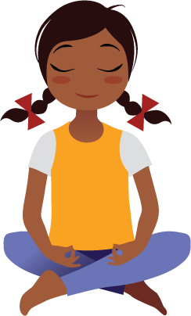
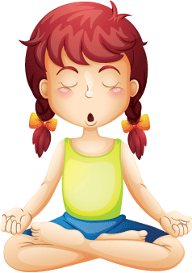
Let’s Focus on Our Breath!
Breath in
Rest
Breath Out
Notes:
Share with the children that when we find ourselves in times of stress or when we are feeling anxious or concerned, we can calm ourselves by focusing on our breath.
Click the next slide to share the Pace Breathing activity. It is 3 minutes long, but you can stop it when needed.

Slide 9
Pace Breathing Exercise
Notes:
Share the pace breathing video with the children.
https://youtu.be/aNXKjGFUlMs

Slide 10
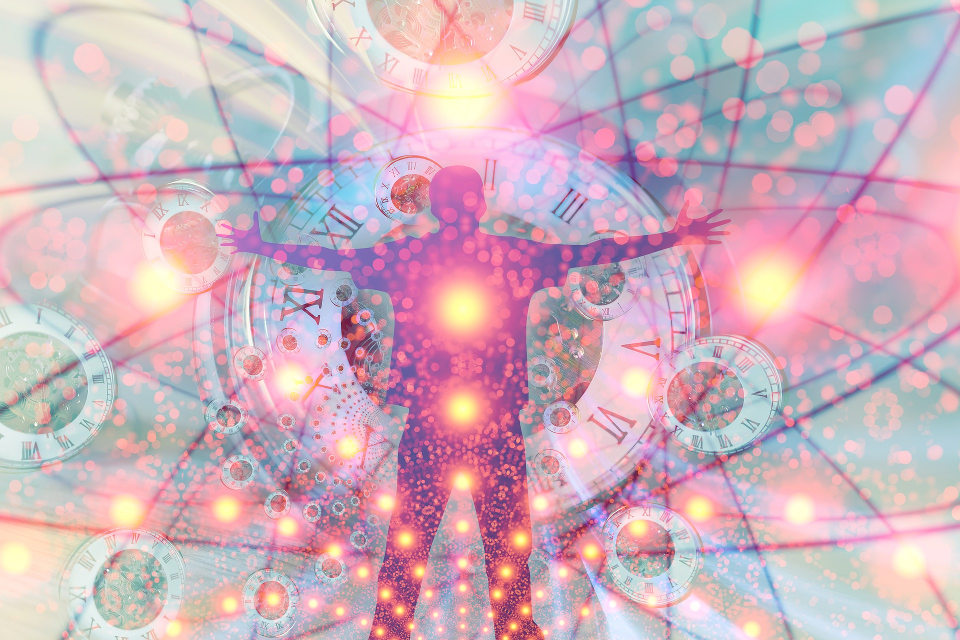
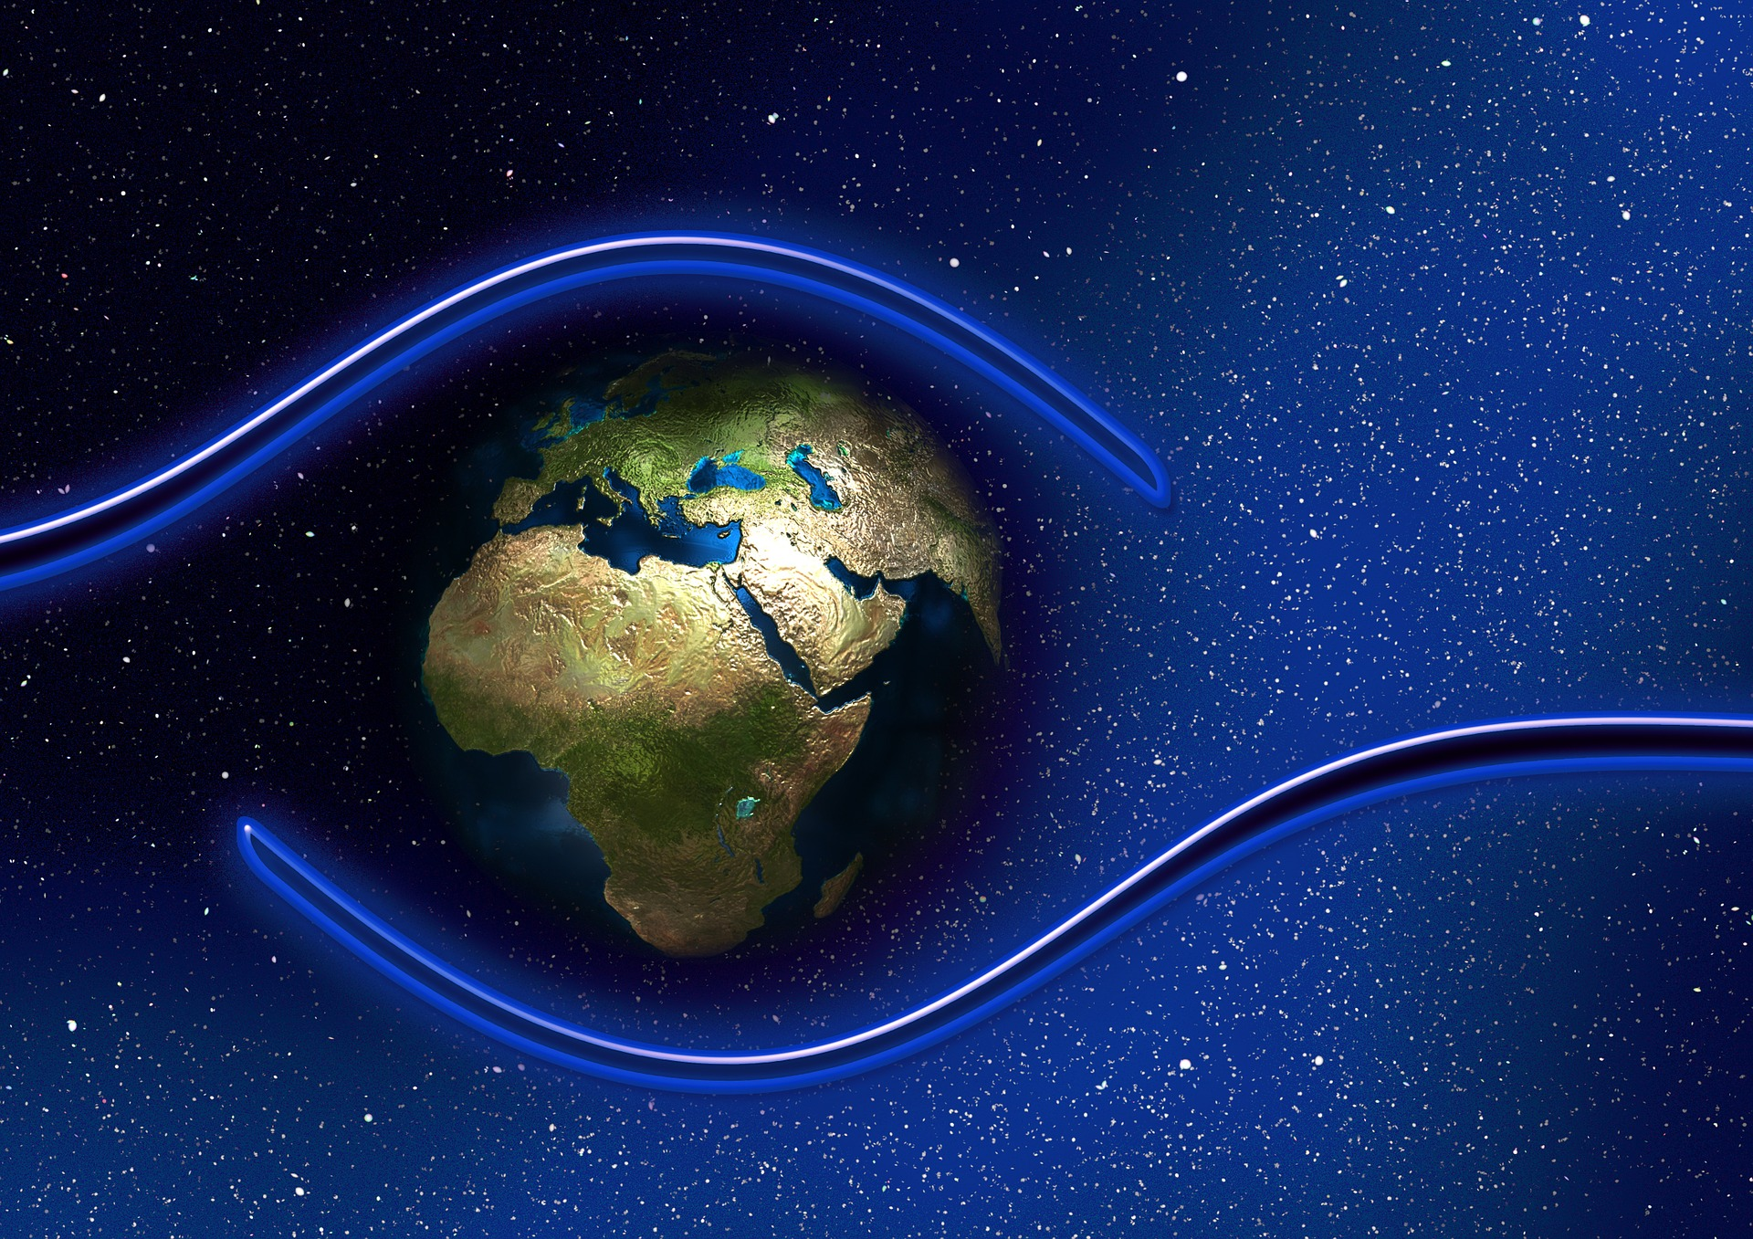
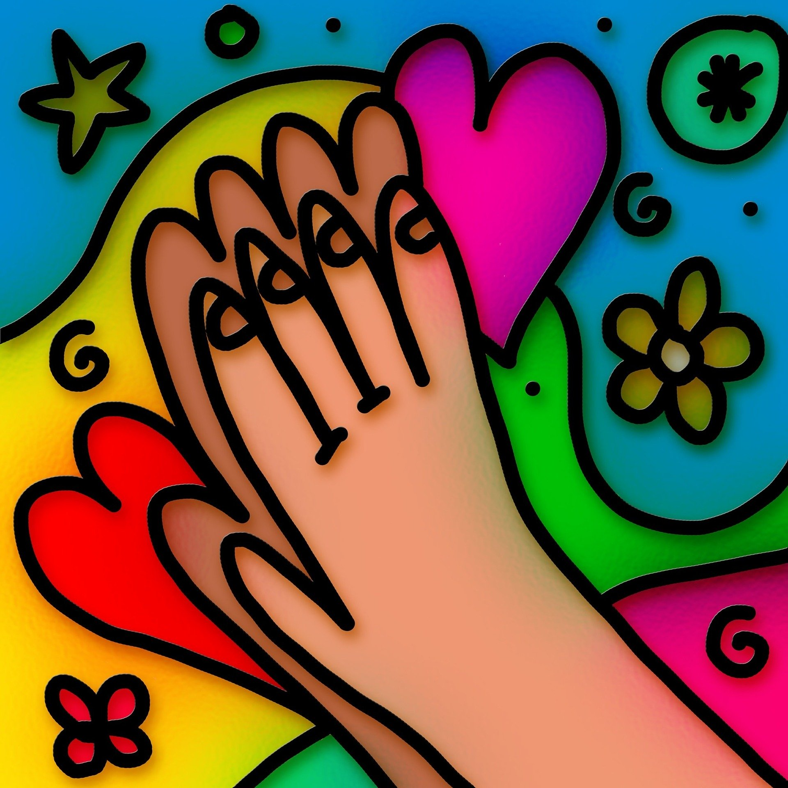
Prayer for Protection
The Light of God surrounds us
The Love of God enfolds us
The Power of God protects us
The Presence of God watches over us
Wherever we are God IS! And all is well.
Notes:
Share the Prayer for Protection.
Also include other closing activities that are traditionally done in your ministry, if appropriate.

